Slide 1
ALA Treasurer’s Report
2022-2023 ALA CD#13.3
2023 ALA Annual Conference
ALA Council
June 26, 2023

Slide 2
FY 2023 YTD Financial Results
As of March 31, 2023

Slide 3
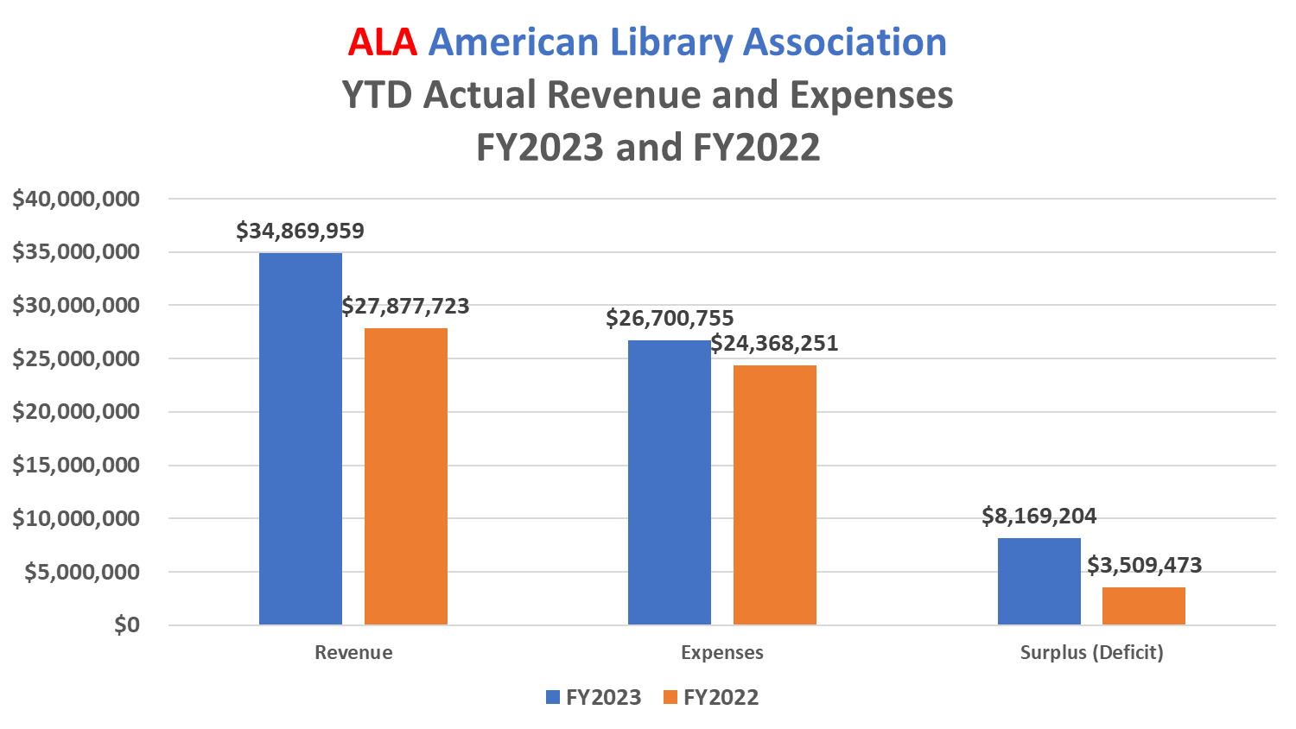

Slide 4
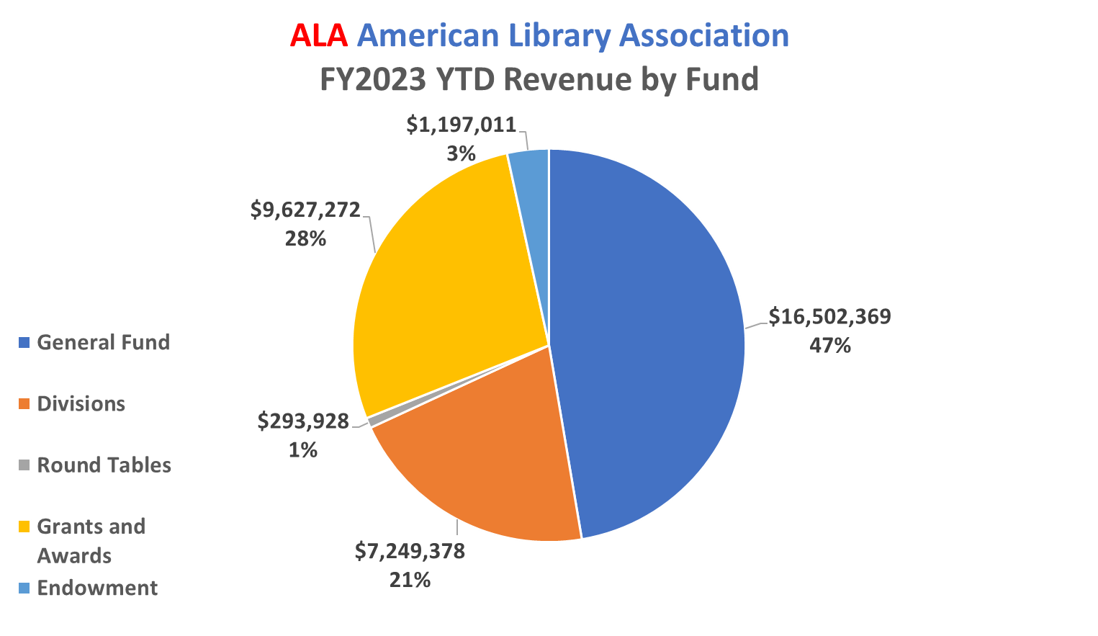

Slide 5
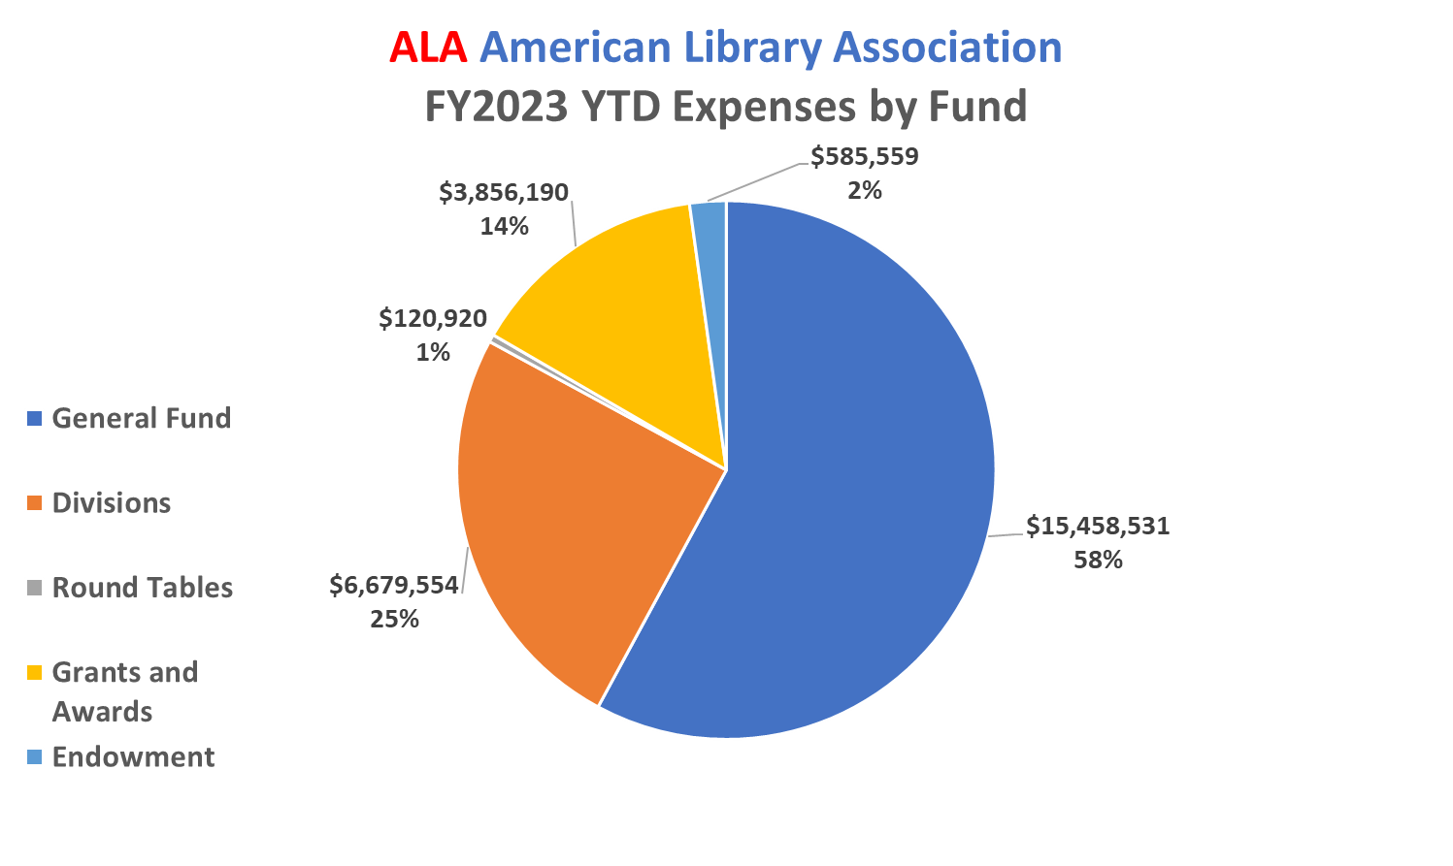

Slide 6
FY 2024 Budget Objectives

Slide 7
Budget Objectives
Align revenue/expense budget
Rebuild membership base
Monitor new revenue sources
Develop budget surplus
Focus on financial stability
Develop new budget metrics

Slide 8
FY 2024 Budget Overview

Slide 9
FY2024 Budget Overview
 | FY2023 | FY2024
Total Revenues | $49,416 | $50,542
Total Expenses | $49,365 | $50,477
Total Surplus / (Deficit) From Operations | $51 | $65
($ in thousands)

Slide 10
Enjoy the rest of your conference!

